Slide 1

Micro Credit loan
Mahaboob Basha Shaik

Slide 2
Problem Statement
A Telecom organisations wants to lend money to it customer with support of mobile financial services (MFS) which they feel are more convenient and efficient, and cost saving, than the traditional high-touch model used since long for the purpose of delivering microfinance services.
MFI to provide micro-credit on mobile balances to be paid back in 5 days.
They wanted to find target customers who can payback the credit on time. This can be observed by their avg usage of Mobile and their credibility of repayment.

Slide 3
My understanding
Micro Credit on mobile phone balances which help the customer in having uninterrupted communications.
Targeting the selected customer who are creditable in repaying of Micro Loans help Telecom Company a repetitive cashflow and customer satisfaction is achieved.
Communication being important part no one want to run out of balance and these leading would help in missing out the service blockages and helps in never ending customer lifetime with the brand.
Focus is on providing their services and products to low-income families and poor customers that can help them in the need of hour.

Slide 4
Eda
Checked weather the Null values present in Dataset.
Converted all float datatype into Int64 datatype.
Treating the skewness with square root and cube root method.
Outliers were identified using box plot.
Data description is used to check the central tendency.
Scaling method is used to scale the data to standard range or normalized real values
Yeo-Johnson helps in transforming the data to have Gaussian distribution.

Slide 5
Steps and assumptions
Ensuring skewness, outliers are treated properly and dataset is ready for model testing.
X and Y variables are assigned with Independent data and Target data.
Import libraries like sk.learn linear model, Decision Tree, Random Forest Regressor and other libraries.

Slide 6
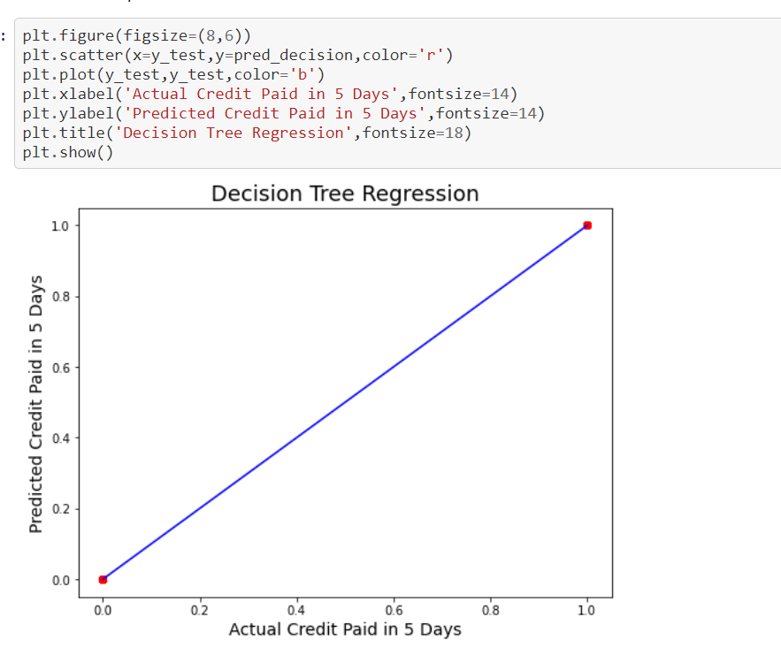
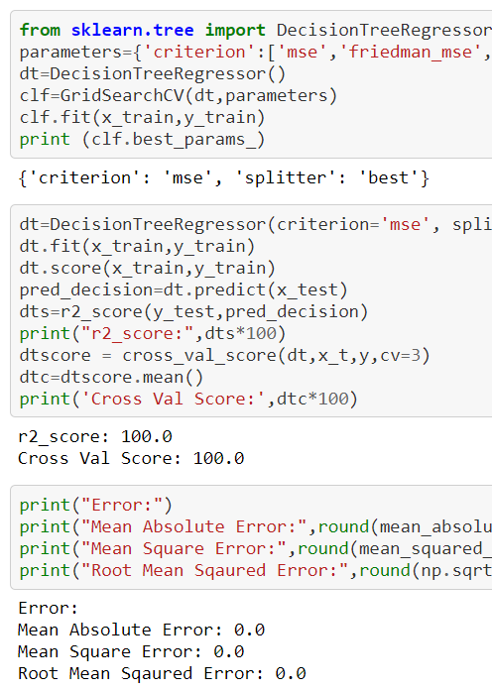
Model dashboard

Slide 7
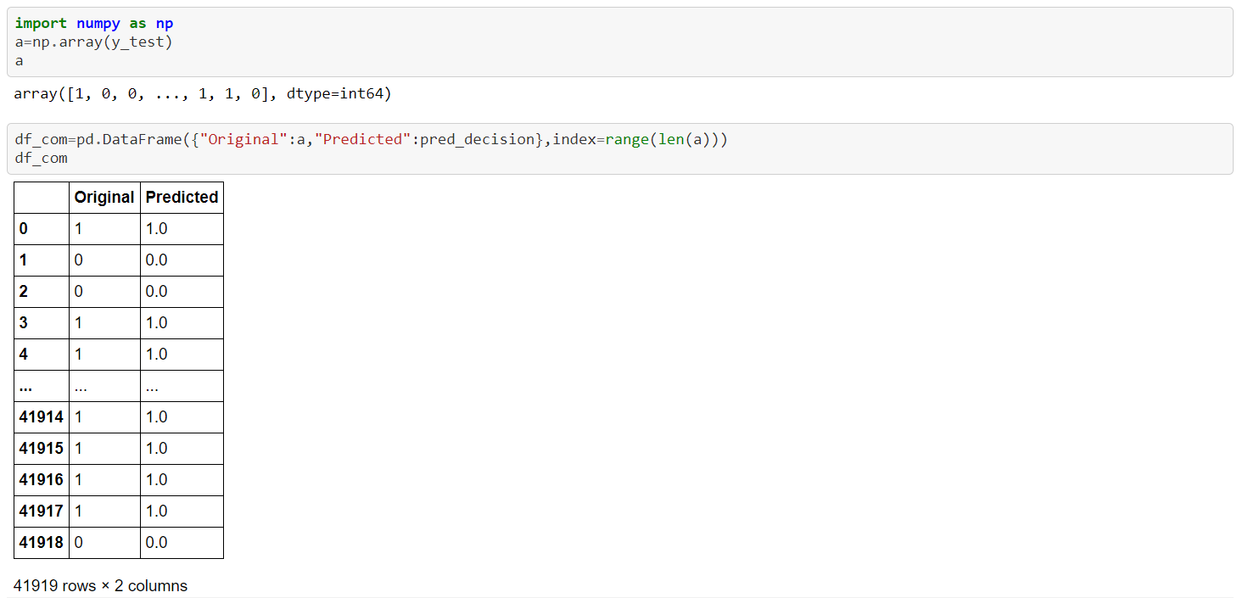
Model Performance
Predicted is having high-level of accuracy.
Decision tree model is the best model when compare with other models.
Having the error 0

